Slide 1
Predicting and analysing urban Water Quality using Machine Learning

Slide 2
Team No:- VIT-028 Team Members
19BCI7101 –K.MOHAN VIKAS Reddy
19BEC7150 - Bolisetty Surya Prakash
19BCI7068 - Desaboina Deekshitha
19BCE7052-LAKSHMI LAAZWANTHI MARELLA
19BCN7085 - Koganti Harsha Vardhan
19BCE7282- Nalabolu Vishal Reddy

Slide 3
INDEX
Introduction
Problem Statement
Dataset
Prediction
Project Flow
Software Specifications
Flow Chart
Model analysis for .ipynb file
User_Interface
Input_Interface
Output_Interface

Slide 4
Introduction
Water is considered as a vital resource that affects various aspects of human health and lives. The quality of water is a major concern for people living in urban areas. Quality of water serves as a powerful environmental determinant and a foundation for the prevention and control of waterborne diseases. However predicting the urban water quality is a challenging task since the water quality varies in urban spaces non-linearly and depends on multiple factors, such as meteorology, water usage patterns, and land uses, so this project aims at building a Machine Learning (ML) model by considering all water quality standard indicators.

Slide 5
Problem Statement
The project aims to build an ML model to analyze and predict the water quality, considering all the water quality standard indicators.
Data preprocessing based on the dataset, training a regression model for prediction.
Creation of API through Flask for a user friendly interface.

Slide 6
Dataset
So here we consider the Water_dataX.csv
It contains the following columns
'D.O. (mg/l)' :' dissolved_oxygen’
'CONDUCTIVITY (µmhos/cm)’
'B.O.D. (mg/l)' : 'biological_oxygen_demand’
'NITRATENAN N+ NITRITENANN (mg/l)’
'TOTAL COLIFORM (MPN/100ml)Mean’
'STATION CODE’
'LOCATIONS’
STATE
PH

Slide 7
What we need to predict from the dataset?
We have to predict the water quality index(wqi) by using the above input variables. By using water quality index we can predict whether the water is contaminated or not. Hence wqi is the output column to be predicted. The index ranges from 1 to 100; a higher number indicates better water quality.

Slide 8
Project Flow
User interacts with the UI (User Interface) to enter Data
The entered data is analyzed by the model which is integrated
Once model analyses the input the prediction is showcased on the UI

Slide 9
To accomplish this, we have to complete all the activities and tasks listed below
Data Collection.
Collect the dataset or Create the dataset
Data Preprocessing.
Import the Libraries.
Importing the dataset.
Checking for Null Values.
Data Visualization.
Taking care of Missing Data.
Label encoding.
One Hot Encoding.
Feature Scaling.
Splitting Data into Train and Test.
Model Building
Training and testing the model
Evaluation of Model
Application Building
Create an HTML file
Build a Python Code

Slide 10
SOFTWARE SPECIFICATIONS
Jupyter Notebook- open source web application that you to create and share documents that contain live code, equations, visualizations and narrative text.
Spyder- web API using the Flask framework We will run our .py through Anaconda Promt

Slide 11
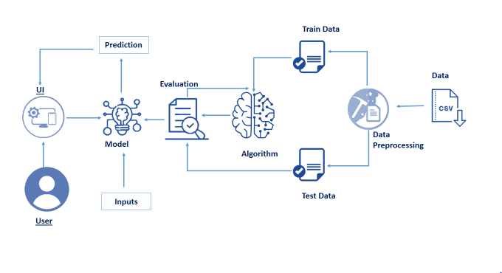
FLOWCHART

Slide 12
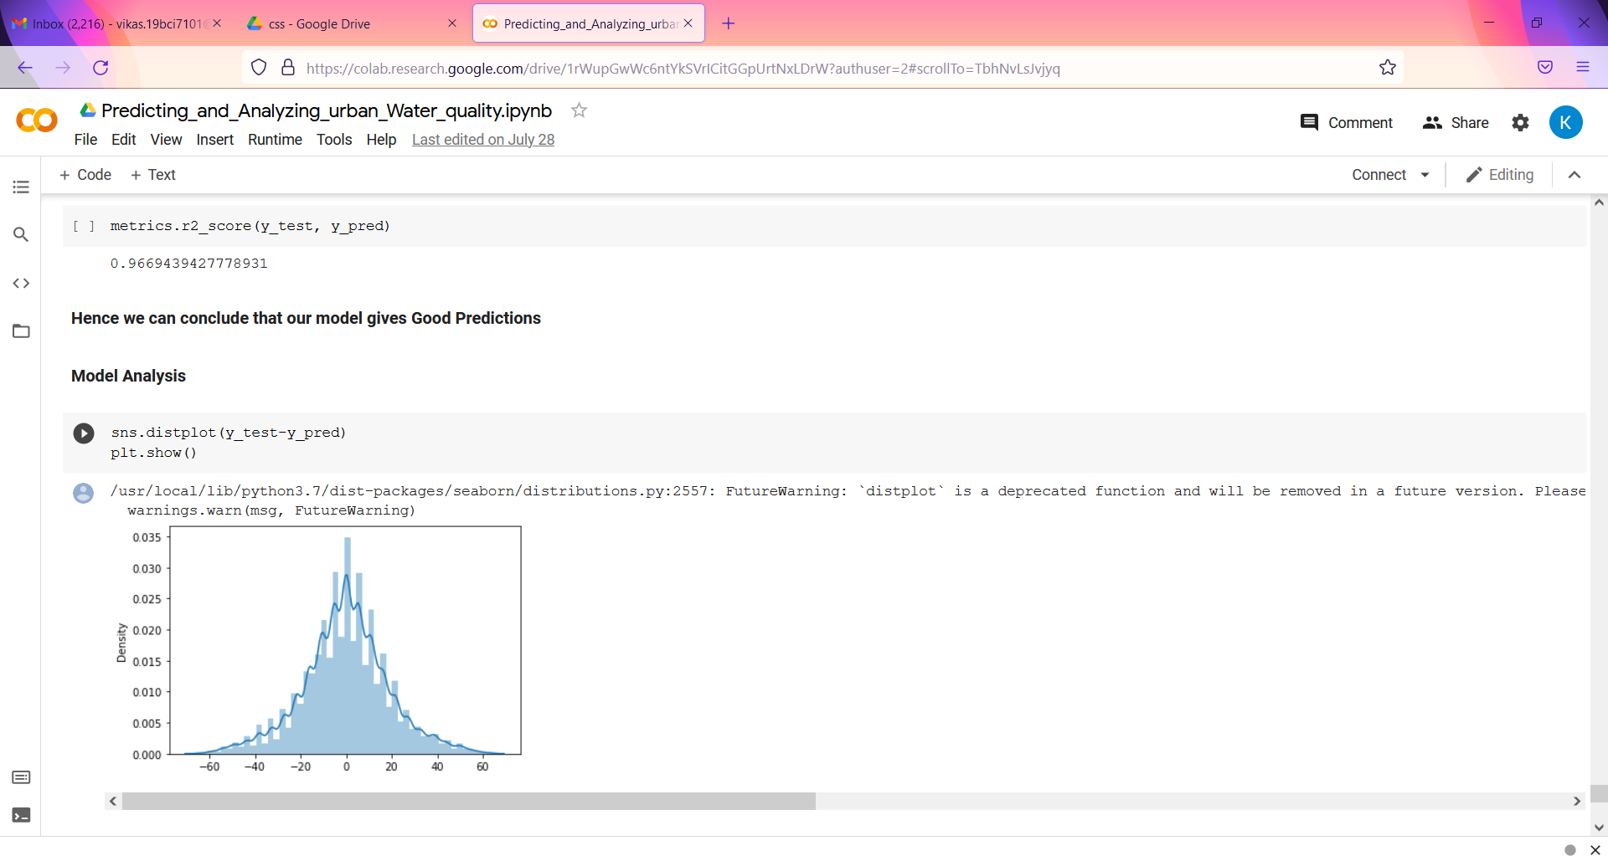
Model analysis for ipynb file

Slide 13
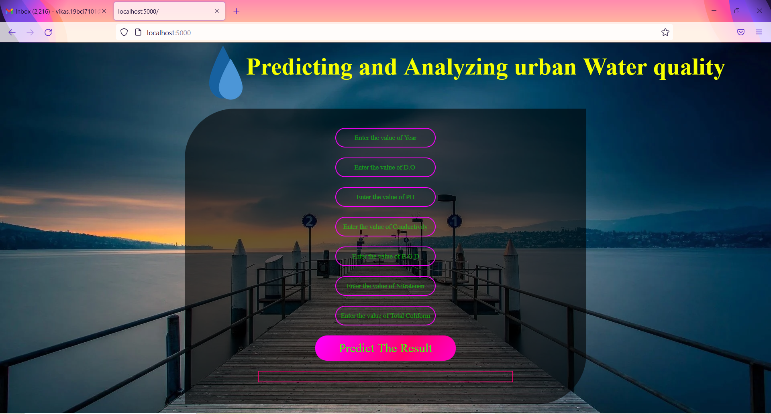
User_Interface

Slide 14
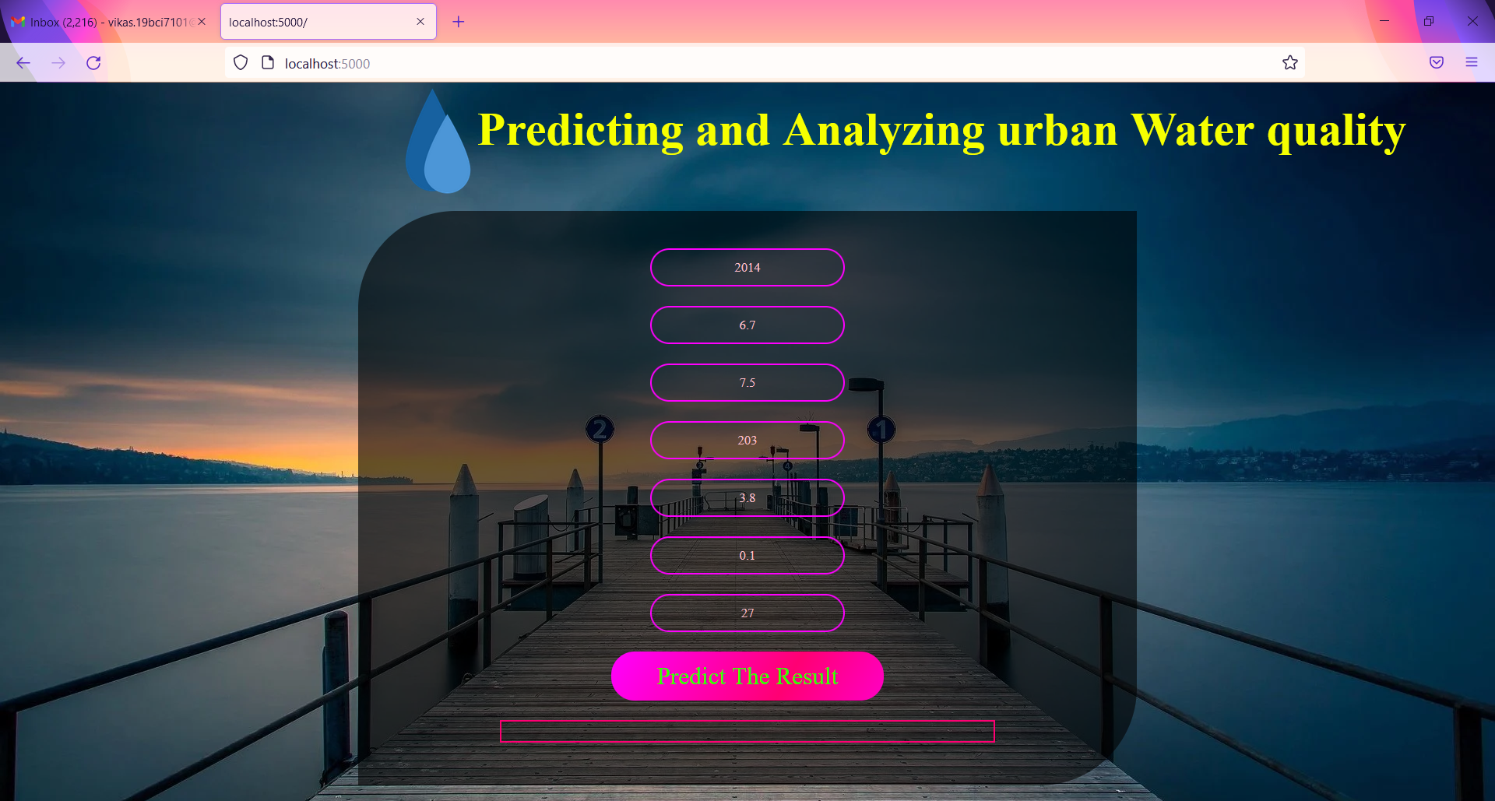
Input_Interface

Slide 15

OutPut_Interface

Slide 16
FUTURE SCOPE
Global water supplies are expected to come under increased stress due to increased demand caused by population growth, rising wealth levels, dietary change, urbanisation, and rising industrial demand. Most of the world's water is currently used to produce food and that is likely to still be the case in 2050.

